Slide 1
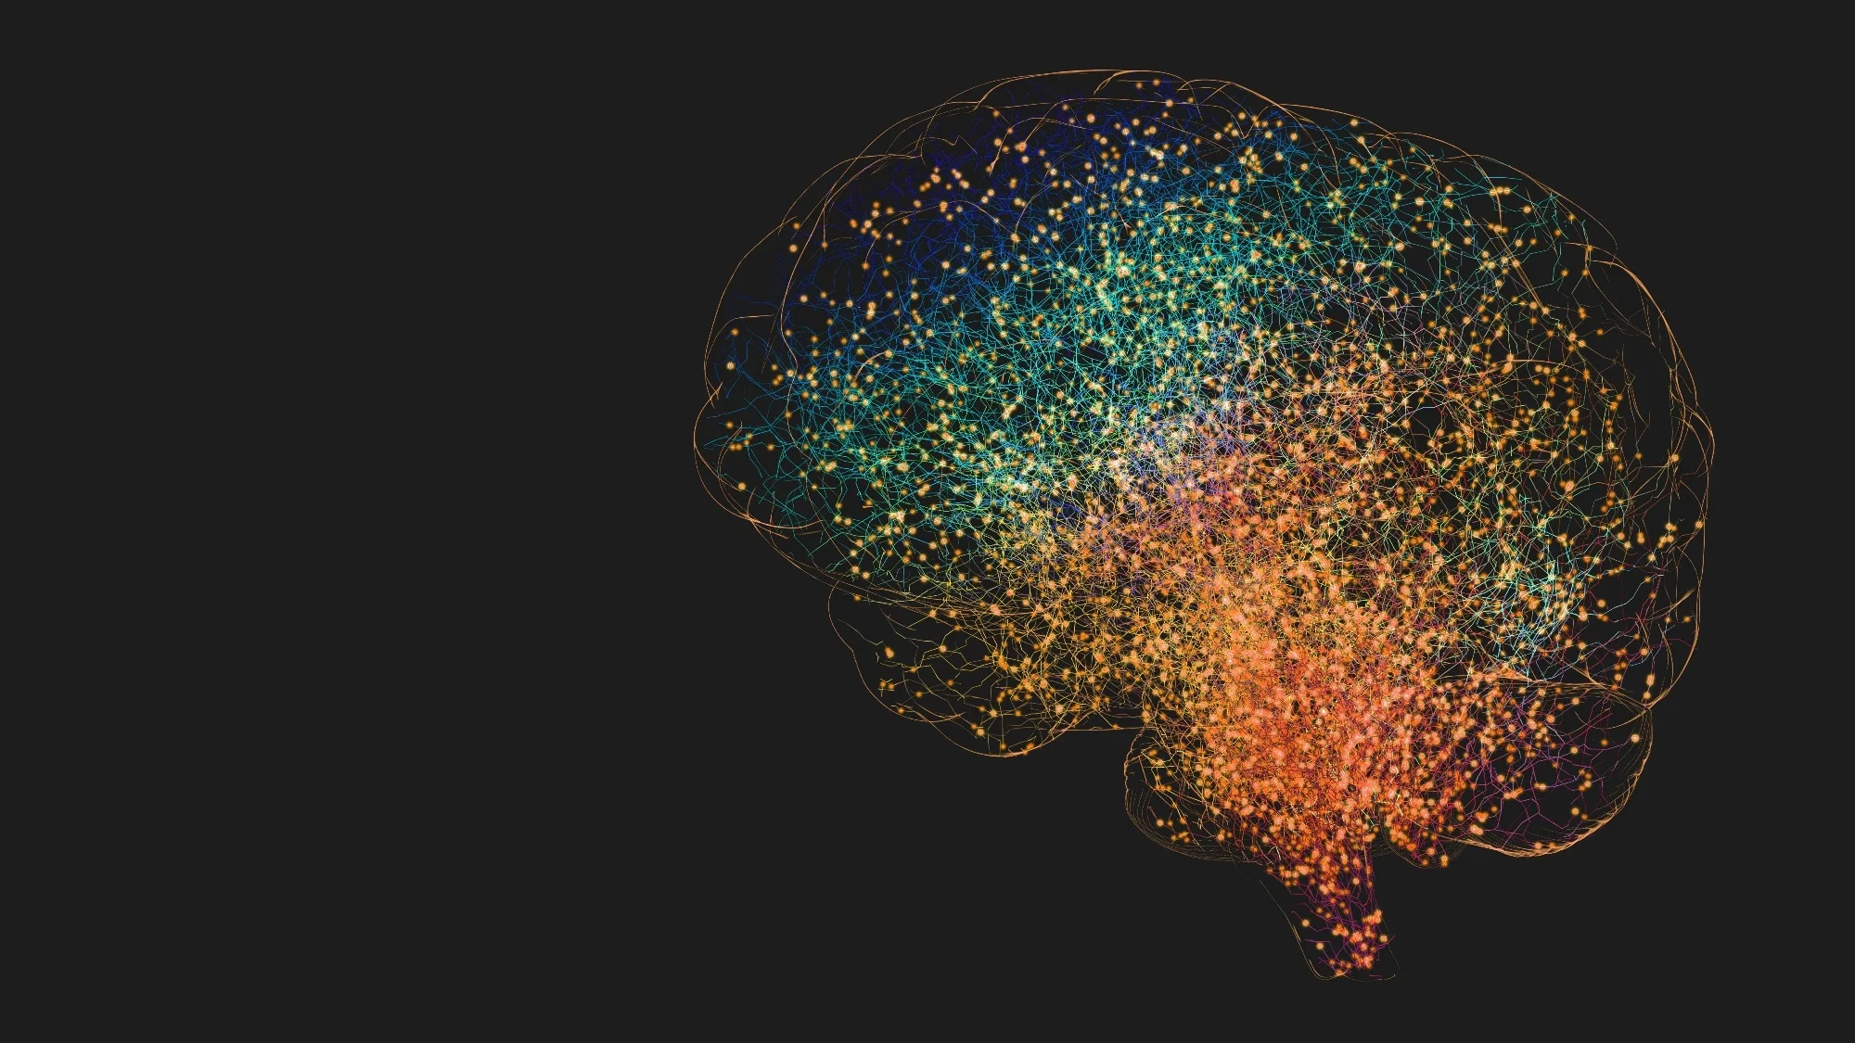
UNDERSTANDING
THE BRAIN
From recording electrical activity
to understanding brain networks
BIOELECTRICITY → SIGNALS → NETWORKS → INTELLIGENCE
Notes:
[object Object],[object Object]

Slide 2
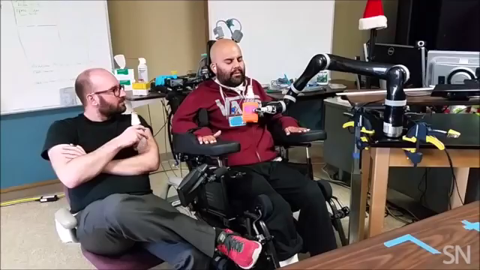
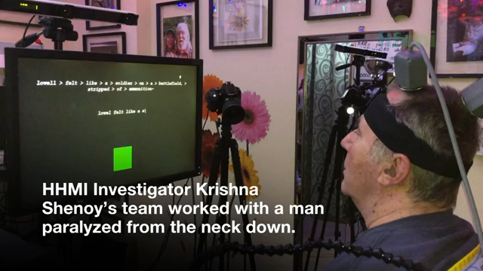
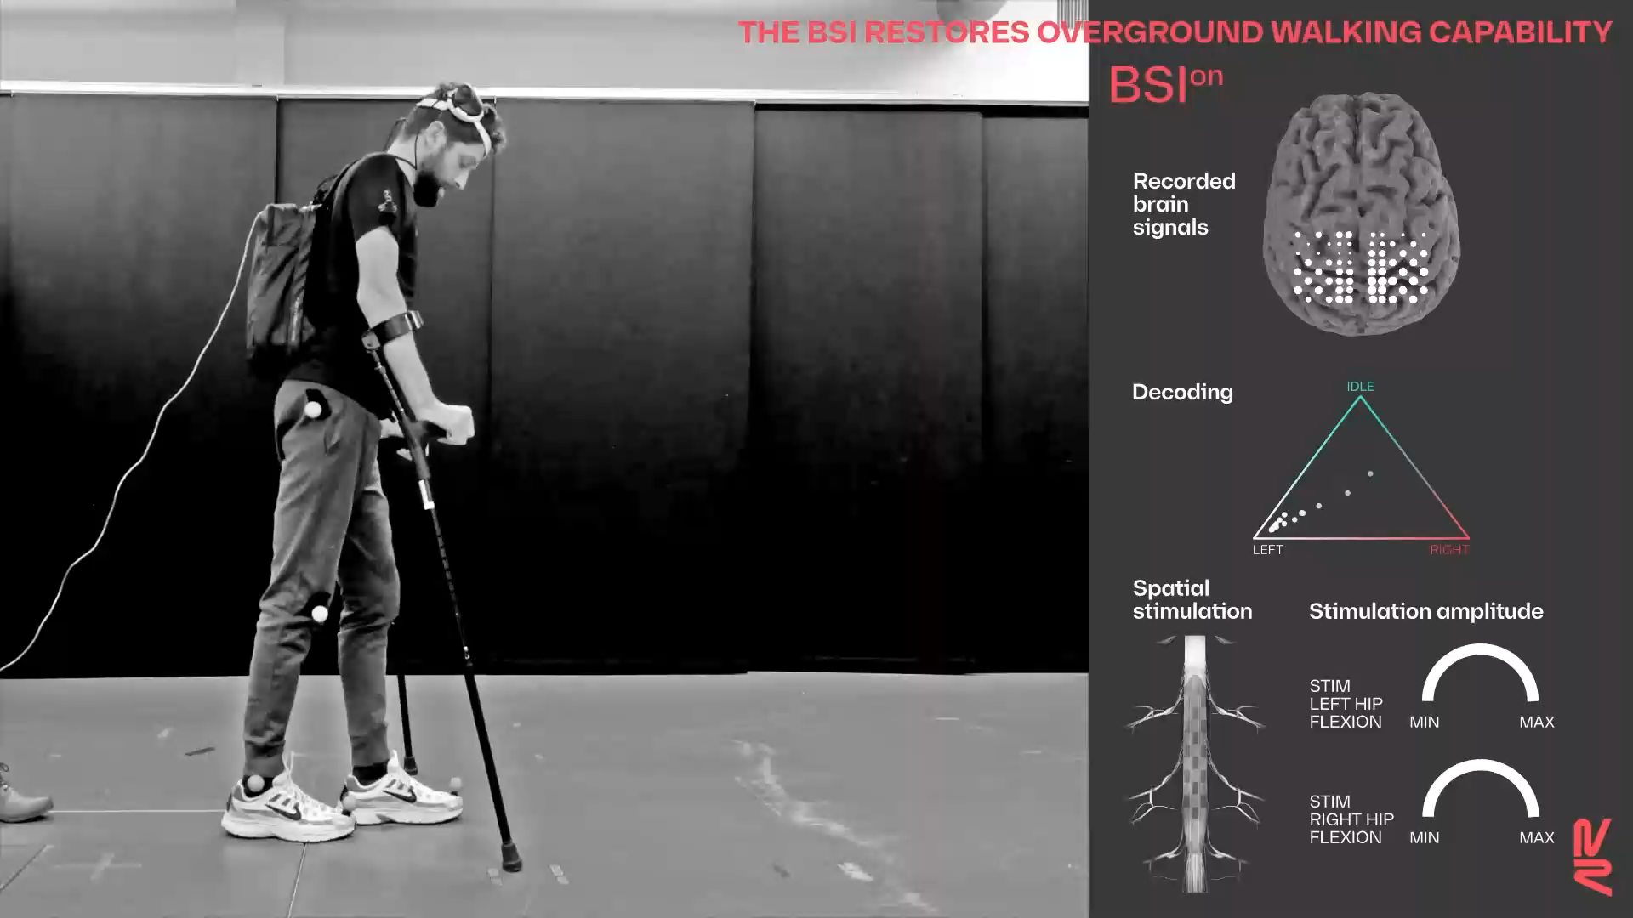
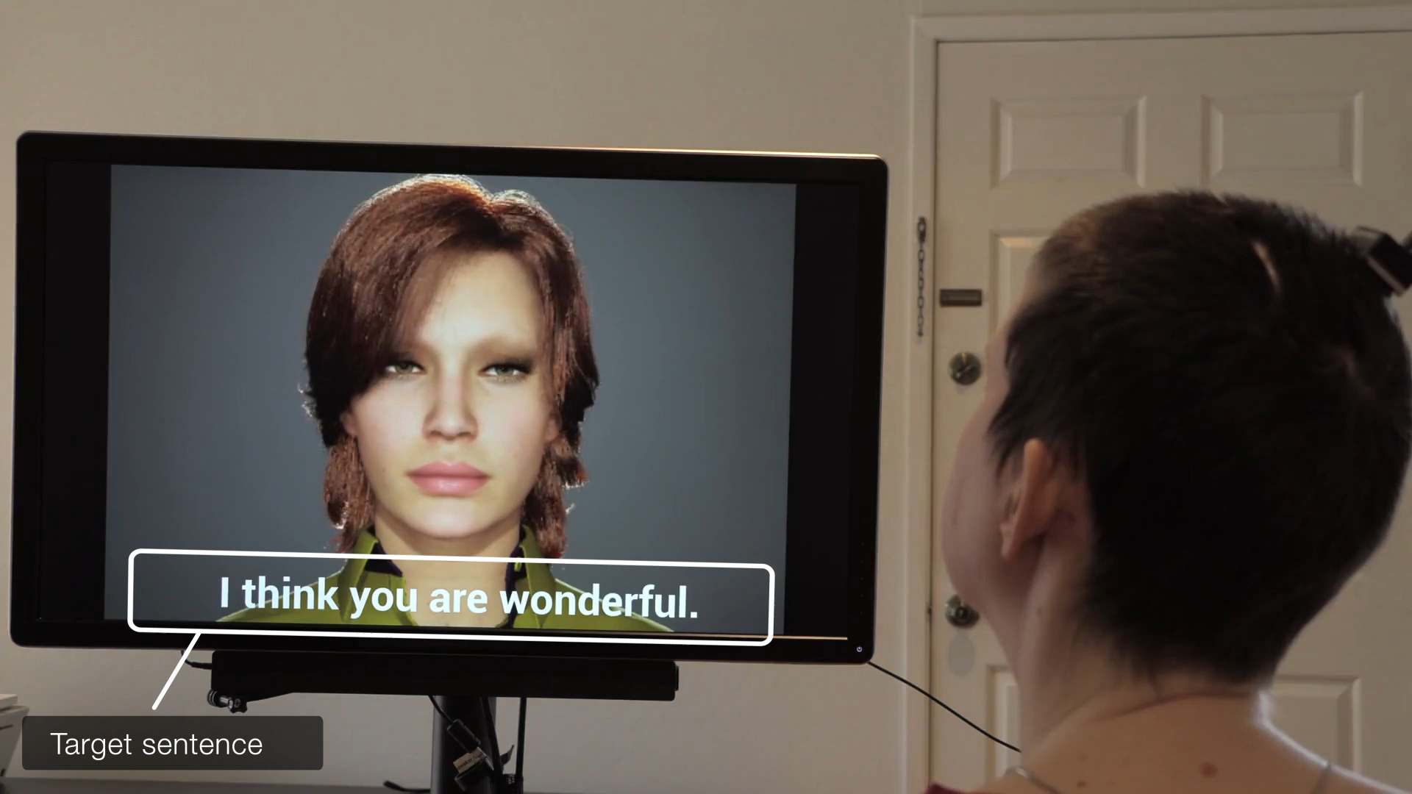
Today, the brain can become an interface
Record → Decode → Act
T. Aflalo et al., Science‘15
F. R. Willett et al., Nature‘21
Lorach et al., Nature’23
Metzger et al., Nature’23

Slide 3
What is missing?
Convenience
Safety
Privacy
But more importantly…
listening is not the same as understanding.

Slide 4
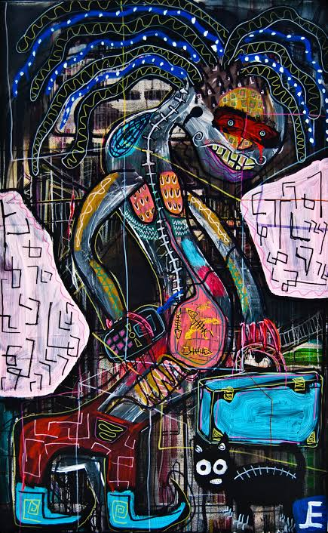
The signal is distributed.
The meaning lives in the network.
1 in 7
people worldwide live with
a mental ailment
WHO · 2023 estimate
How do we recognize a multi-region brain state?
Notes:
[object Object],[object Object],[object Object]

Slide 5
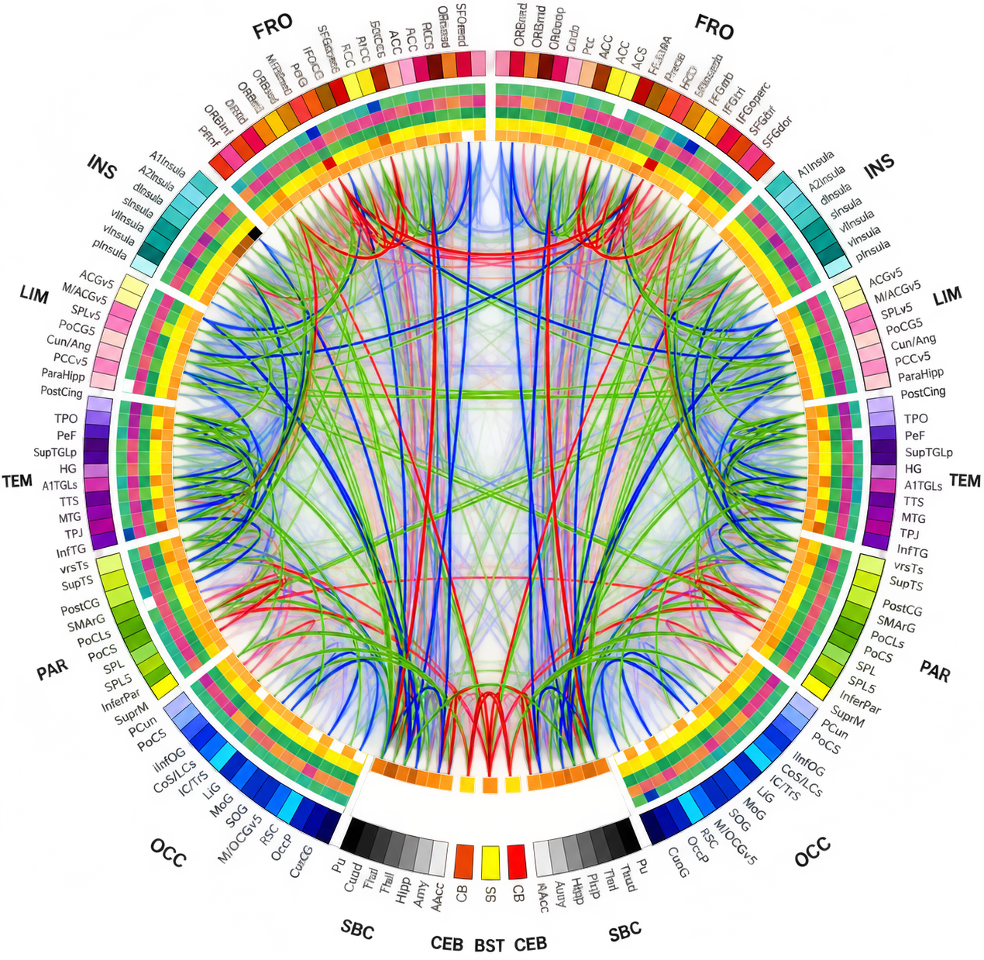
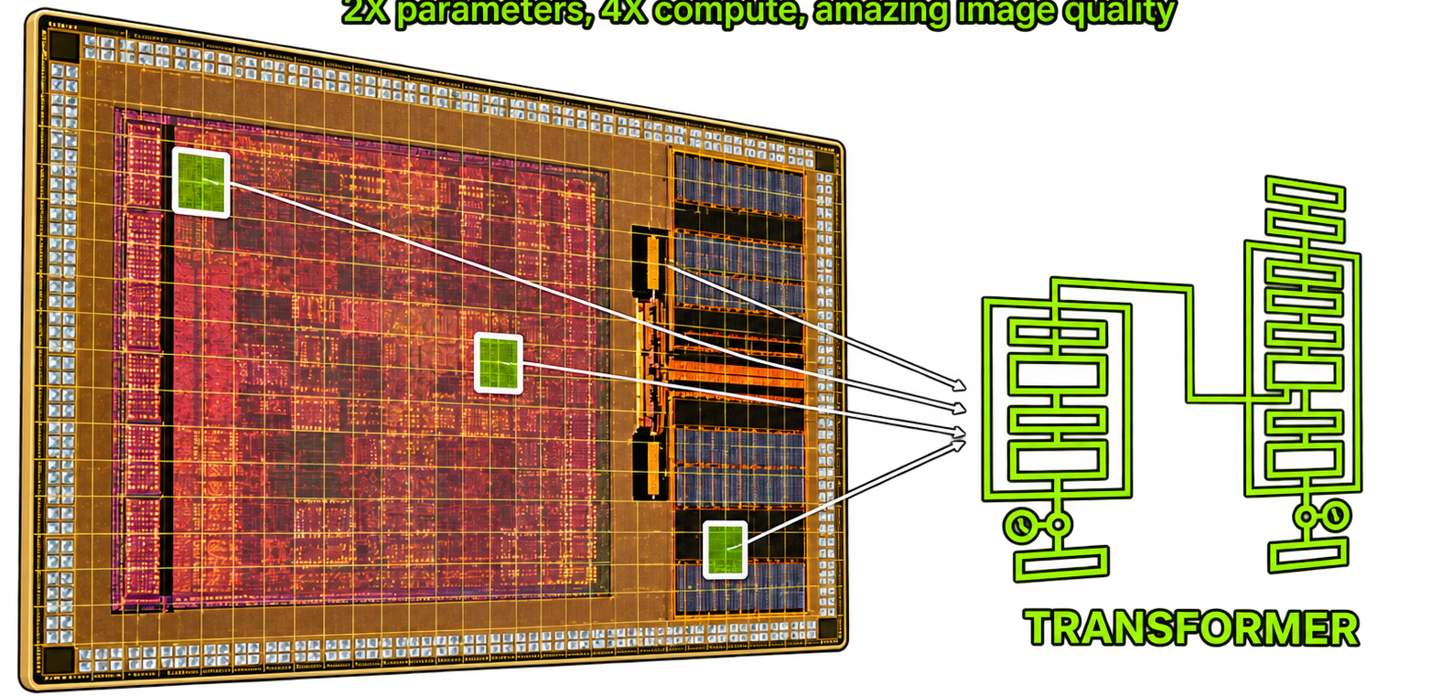
From brain signals → Inter-regional brain networks
TRANSFORMER
learns relationships
across channels · regions · time
Connectivity becomes a biomarker.
Notes:
[object Object],[object Object]

Slide 6
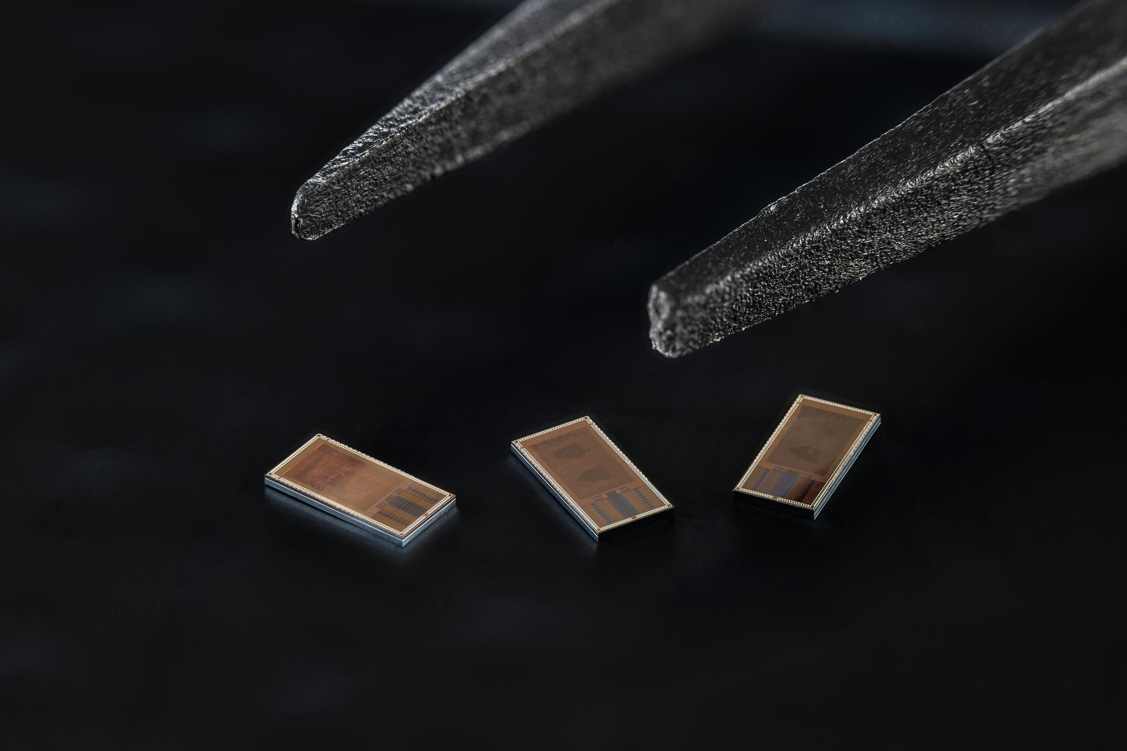
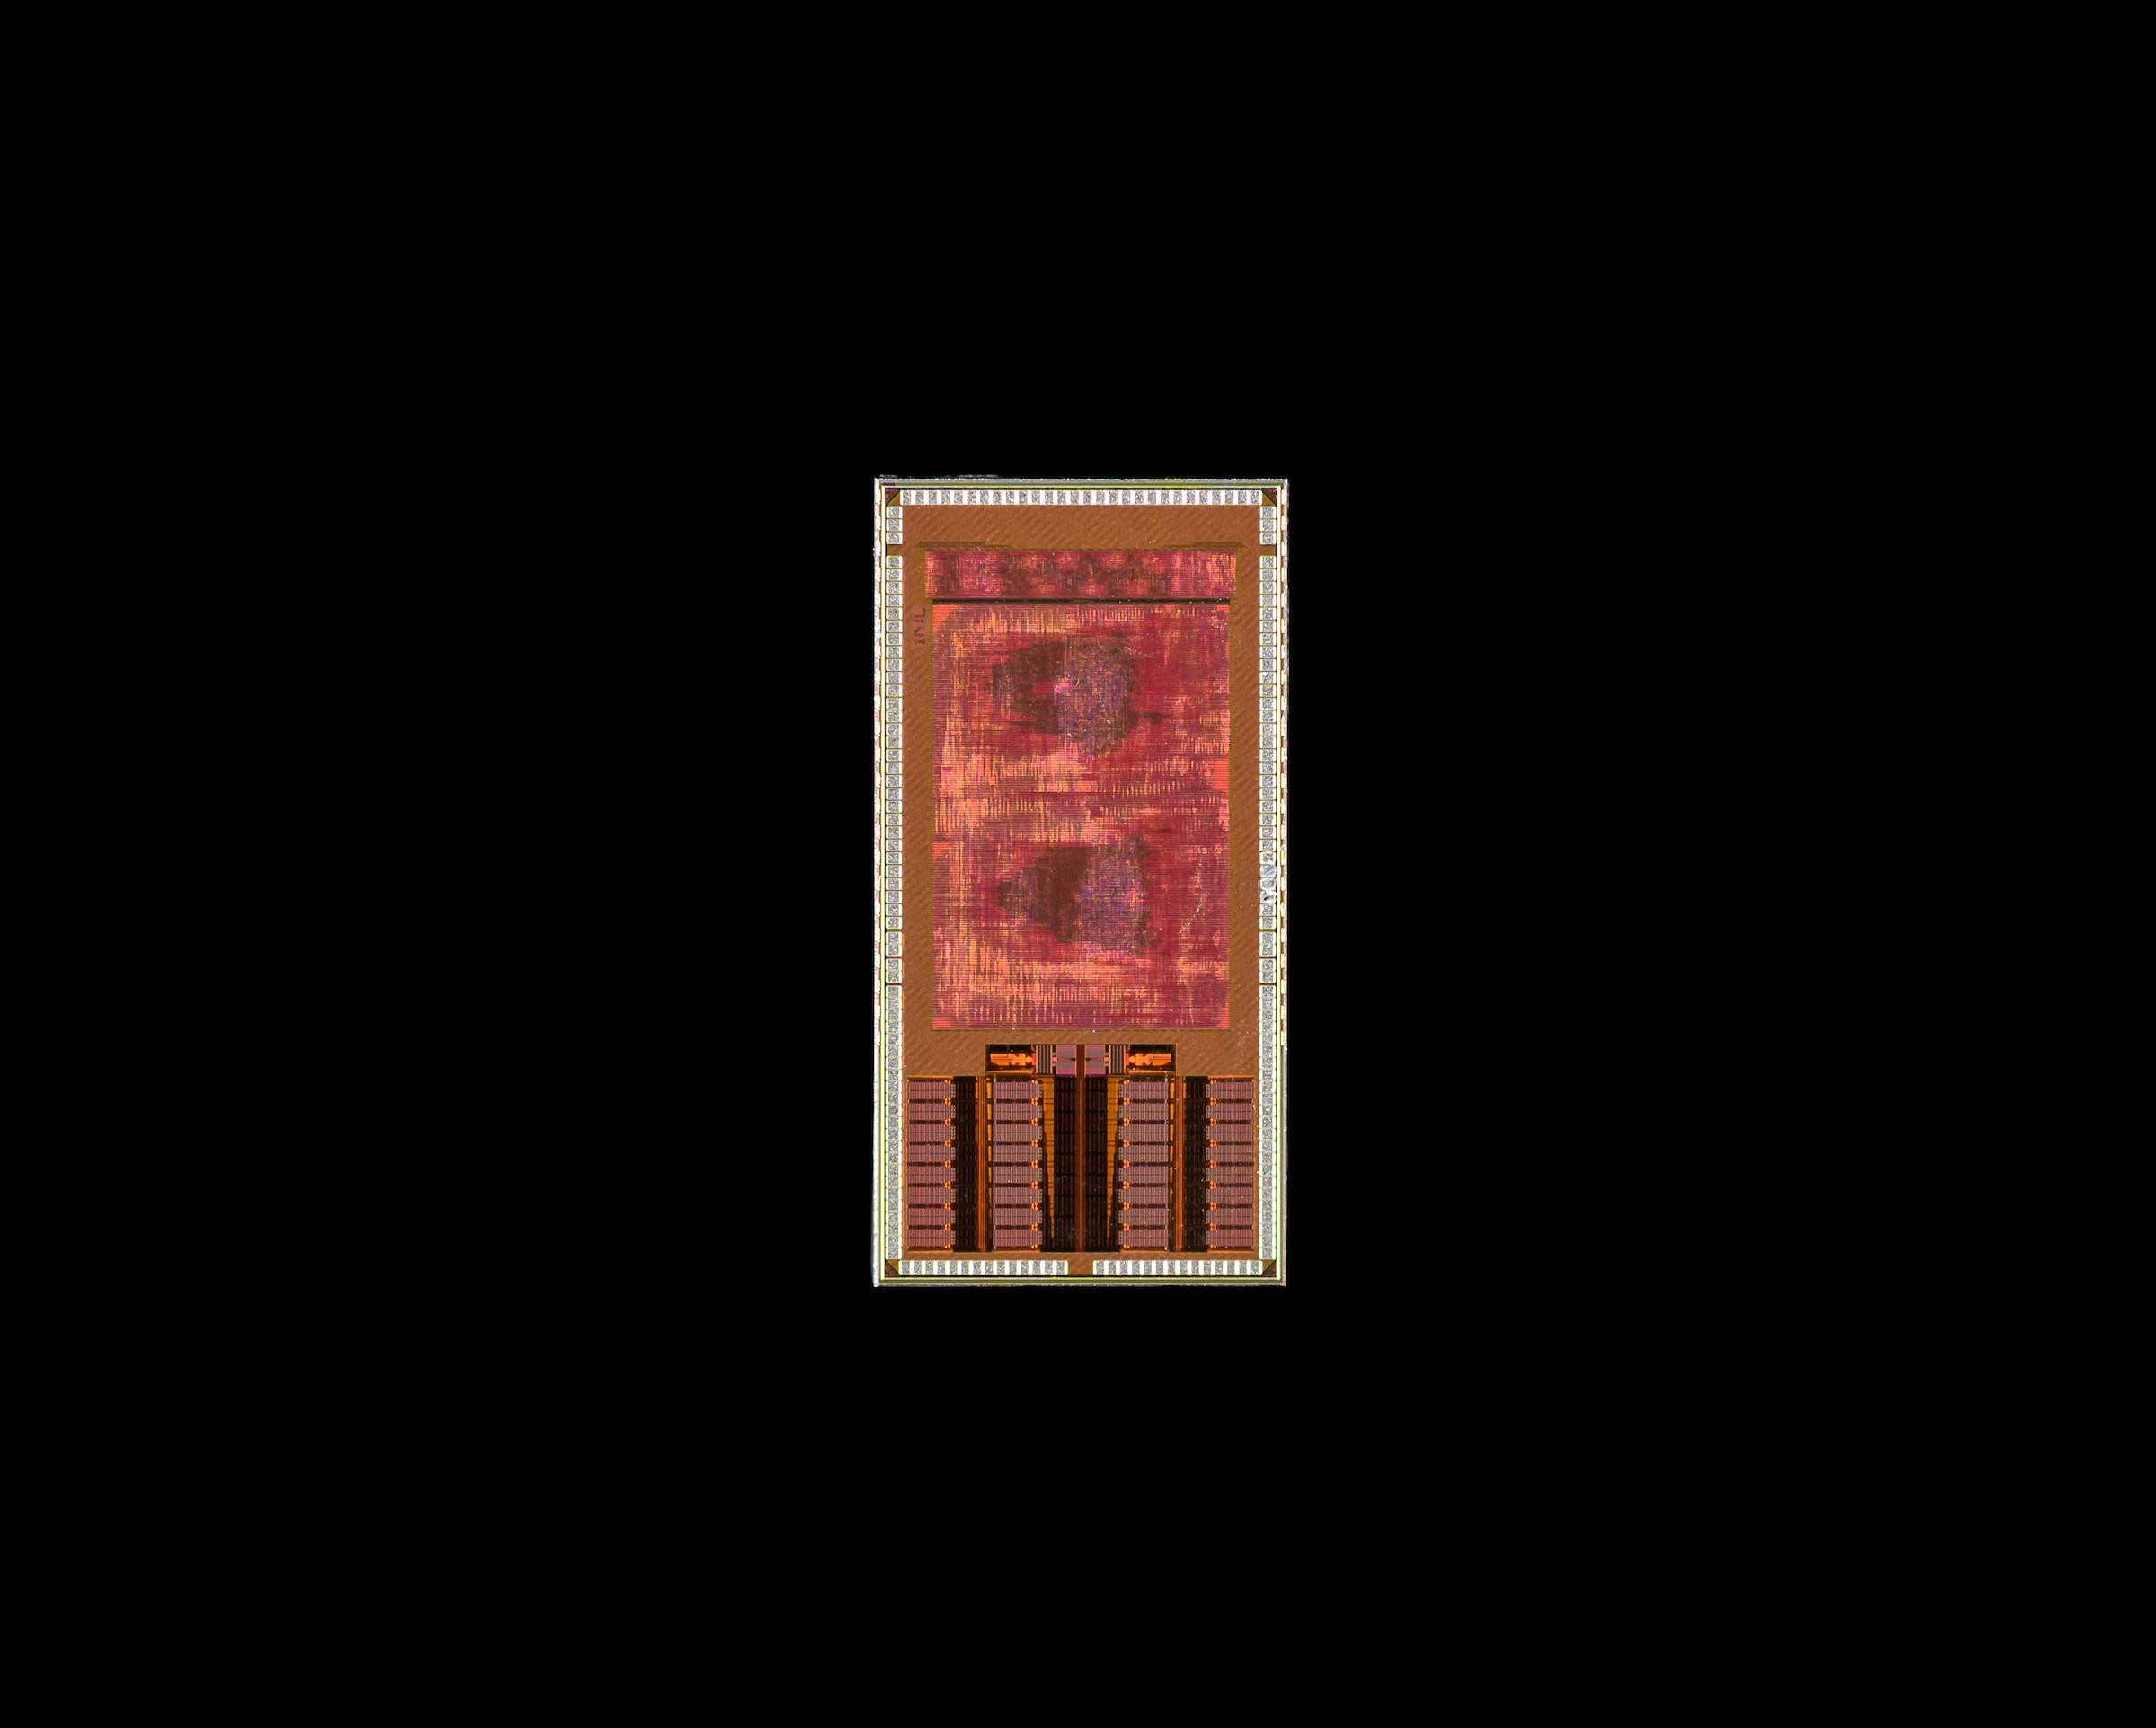
Powerful AI is useful only if it can live with the brain.
MY RESEARCH
Transformer intelligence,
compressed into an ASIC
INL’s LogSync ASIC for Brain region connectivity extraction
low power · real-time · on-device
Notes:
[object Object],[object Object],[object Object]

Slide 7
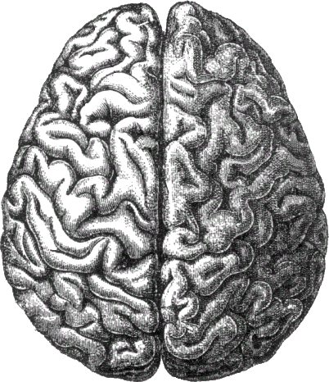
From understanding the brain… to responding to it.
RECORD
CONNECT
neural signals
network biomarkers
CLOSED LOOP
RESPOND
UNDERSTAND
neuromodulation
transformer AI
My PhD research: building the intelligence that closes the BCI loop.
Understand the network. Recognize the state. Intervene at the right moment.
Notes:
[object Object],[object Object]

